Slide 1



A CENTER FOR INTER-DISCIPLINARY RESEARCH
2018-19
AAC LOGIN FORM
SUPERVISED BY
MACHERLA SRIKANTH REDDY
GOKARAJU RANGARAJU
INSTITUTE OF ENGINEERING AND TECHNOLOGY
AUTONOMOUS

Slide 2

Advanced Academic Center
( A Center For Inter-Discilinary Research )
This is to certify that
AAC LOGIN FORM
is a bonafide work carried out by the following students in partial fulfilment of the requirements for Advanced Academic Center intern, submitted to the chair, AAC during the academic year __________2018-19_____________
NAME | ROLL NO. | BRANCH
P.Ramya | 18241A05M4 | CSE
V Niharika | 18241A05T8 | CSE

Slide 3
NAME | ROLL N0 | BRANCH
M Poojitha | 18241A05X1 | CSE
U Reshma Shravani | 18241A05Z5 | CSE
D Teja sree | 18241A05P1 | CSE
A Harshitha | 18241A05I5 | CSE
Dr/Ms./Mr.
Dr.B.R.K.Reddy
Program Coordinator
Dr.Ramamurthy Suri
Associate Dean,AAC
Project Supervisor

Slide 4


ACKNOWLEDGEMENTS
We express our deep sense of gratitude to our respected Director , Gokaraju Rangaraju Institute of Engineering and Technology for the valuable guidance and for permitting us to carry out this project.
With immense pleasure, we record our deep sense of gratitude to our respected principal, for permitting us to carry out this project.
We are thankful to Associate Dean ,Advance Academic Centre for providing us appropriate ecosystem required for the project to complete.
We are thankful to our project supervisor who spared valuable time for us and influence novel ideas to guide us. I am indebted to all the above without whom I would not have concluded the project.

Slide 5
TABLE OF CONTENTS
1. | AUTHORISATION | i
2 | ACKNOWLEDGEMENTS | ii
3 | SUMMARY | 6
4 | INTRODUCTION | 7
5 | ABSTRACT | 8
6 | WORKING OF A WEB PAGE | 9
7 | FLOW OF THE PROJECT | 12
8 | ATTACHMENTS | 14
9 | FUTURE SCOPE | 23
10 | REFRENCES | 23
11 | GLOSSARY | 24

Slide 6
SUMMARY
“AAC LOGIN FORM” is about a web page, Through this webpage , one can access to a web site . The website includes webpage by creating accounts in order to access the website information by creating Id and password , the webpage stores information about the user who get login. next time when the user get login it automatically displays the user details , It is a layout for any website which displays the information.This AAC login account is a secured account which can be used by any user by creating their own their own passwords.
Our project contains visuals, technology delivery and purpose.
This is a secure account , in which only self accounts can be accessed . It is easy to access user content . It usually include information such as the colours of the text and backgrounds and very often contain links to images.

Slide 7
INTRODUCTION
The formation of Web page is been projected in this project . The user can store their details by creating accounts in order to view the user information. if the user is accessed for the first time, the login page will be displayed. This page provides a security mechanism that prevents unauthorized users from accessing the system. In order to get the user details, the visitor must provide a valid username and password.
It is common and basic for the all websites which helps the users to know about the website and helps to login in that particular application or website.
A web page is a document that is suitable to act as a web resource on the World Wide Web. In order to graphically display a web page, a web browser is needed. This is a type of software that can retrieve web pages from the Internet . When accessed by a web browser it may be displayed as a web page on a screen Typical web pages are hypertext documents which contain hyperlinks often referred to as links for browsing to other web pages.
Web page delivers user information exactly as stored
a)Any website can add this webpage in order to access the website information by creating accounts
b)If you already had an account ,then you can directly login to your accounts by entering your username and password.
c)It then displays your details like name , roll number , course , on going projects , completed projects , certifications , awards , mentor etc.

Slide 8
d)In case, if you don’t have an account , you can sign up by entering your name and roll number on the other page.
e)Don’t worry if you forgot your password , there is option called forgot password.
f)With this web page , we can know also the details of every AAC student who are dealing with projects and also their certifications.
g)This also helps the mentors to know about their students and their projects.
Web page is accessed by entering a URL address and may contain text graphics and hyper links and other webpages and files.it is all about making web pages viewable by people that use devices to browse the websites
ABSTRACT
AAC LOGIN FORM is a login account whose main aim is to provide all the details of AAC students regarding their projects, certifications and awards. AAC login form usually a text file containing hyper text written in HTML or a comparable marked language. This helps the user to know the details about AAC students. It collects data when the user gets login.
It is accessible through any network using an internet browser . This webpage can be added to any website.
It is based on the planning and creation of websites , which includes site structure , layout , navigation ,fonts , image ,colours etc.

Slide 9
4. WORKING OF A WEB PAGE
Web page includes page layout , front end , back end.
4.1.LAYOUT
A webpage layout is a pattern (or framework) that defines a website's structure. After opening the webpage, we can have two options(login,signin) . Clicking on the Login button, It gives you the login form which asks for username and password . By entering username and password , you can view your details regarding AAC . Clicking on the Sign in button , you can register to create a new account.
4.2. FRONT END
Front end is the graphical representation user interface of a webpage that makes it easier to use. Front end includes HTML and CSS .HTML includes inserting images. Images can improve the design and the appearance of a webpage, writing headings and paragraphs. This also includes class attribute which is used to define equal styles for elements, id attribute specifies a unique id for a html element. Setting the style of an HTML element, can be done with the style attribute. The CSS background properties are used to define the background effects for elements.CSS back ground properties includes background-color, background image,background-position.CSS border properties allows you to specify the style, width and color of an elements- border. CSS padding properties are used to generate space around an element’s content, inside of any defined border. The CSS font properties defines the font family, boldness, size and the style of a text. CSS inline-block allows to set a width and height on the element.

Slide 10
The CSS margin properties are used to create around elements, outside of any defined borders. The CSS border properties allows you to specify the style, width and color of
an element’s border. The border-style property specifies what kind of border to display. The height and width properties are used to set the height and width of an element. The max-width property is used to set the maximum height of an element. The background-image property specifies an image to use as the background of an element. The color property is used to set the color of the text. CSS outline is a line that is drawn around elements, outside the borders , to make the element stand out. The display property is the most important CSS property for controlling layout. The position property specifies the type of positioning method used for an element(static, relative, fixed, absolute or sticky).
4.3.BACK END
The backend refers to parts of a webpage application or a program code that allows it to operate and that cannot be accessed by a user , most data and operating syntax are stored
and accessed in the backend of a computer system.After entering the User Id and password in front end the server checks the user details stored in database , if the details get tally then , it displays your personal details . The backend is also called the data access layer of software or hardware and includes any functionality that needs to be
accessed and navigated to by digital means. In webdevelopment or in web design the back end is handled by engineers or developers.

Slide 11
BACK END OF A SYSTEM INCLUDES
Programming and scripting languages like Python , Django.
Platforms like window command and visual studio code command.
Auto mated testing frame works.
Network scalability and availability.
Data base management and data transformation.
Any web that has a data base integrated into it uses server side , back end programming.
Back end development include writing code to interact with a database using sql.
Back end is a component that offers up energy , power and enables website to grow.
The back end of your web application is the thing that enables a front end experience for your user.
The backend of your user website or webpage is responsible for things such as data base interactions, calculations and performance and most of the coding that is required to make a web page function.
Most of the for any application will be written at the backend.

Slide 12

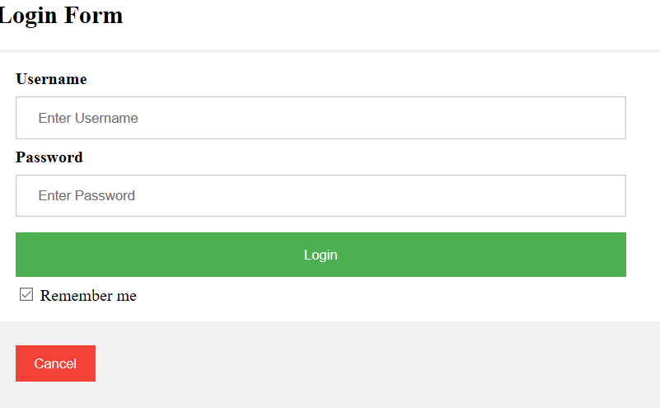
FLOW OF THE PROJECT
When we open the webpage, AAC login form, it has two choices in the first page i.e login and signup . This page has GRIET logo , AAC logo, with a meaningful quotation.
When one is viewing a webpage , a copy of it is saved locally . When we click on the login button a request is sent to the server .The server process the request and then sends a response in the form of login page.

Slide 13
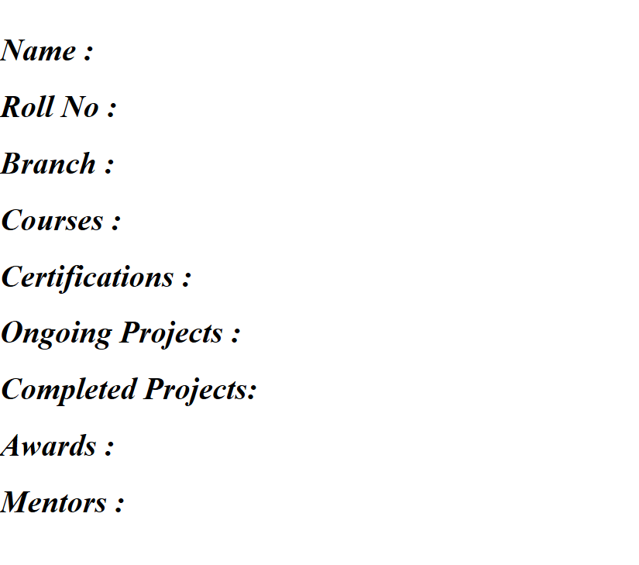
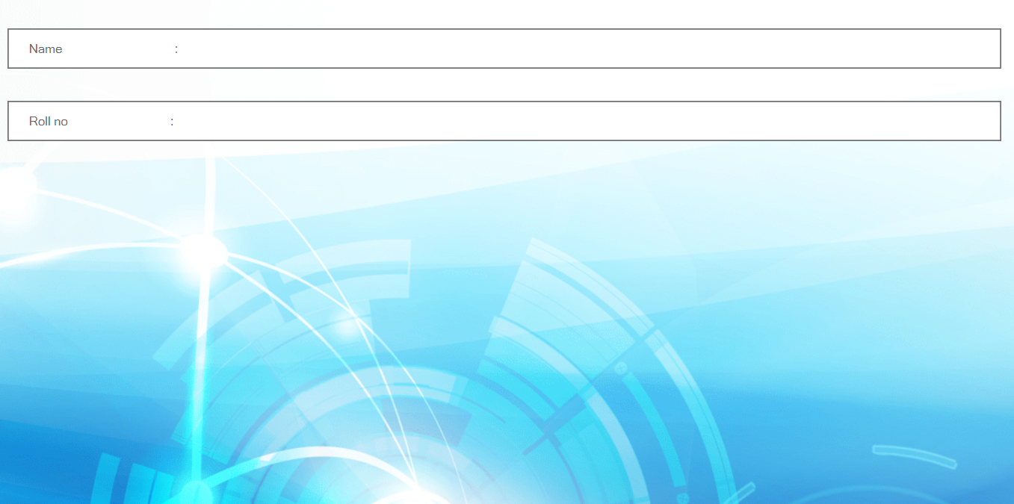
By entering the User Id and password in front page , the server checks the user details stored in database. If the details get matched then , it displays your personal details like name , roll number, branch, course, certifications, completed projects, ongoing projects, awards. If you forget your password, there is an option called forget password in the login page.
When you signup , a request is sent to the server and consequently the server sends response to the user to enter user name and roll number. The account will be created by entering your name and roll number.

Slide 14
FRONT END_CODE1
<html>
<title>GRIET loginform</title>
<head><meta charset="UTF-8">
<meta name="description" content="GRIET loginform">
<meta name="keywords" content="GRIET,AAC,login,form,certificates,awards,projects">
<meta name="author" content="">
<meta name="http-equiv="refresh" content="20">
<meta name="viewport" content="width=device-width, initial-scale=1.0">
</head>
<style>
p{
font-style: italic; }
.bottom-left{
position: absolute;
bottom : 8px;
left: 16px;
}
.button {
background-color: #555555;
border: none;
color: white;
padding: 15px 32px;
text-align: center;

Slide 15
display: inline-block;
font-size: 16px;
margin: 4px 2px;
cursor: pointer;
</style>
<body background="C:\Users\HP'\Downloads\background 3.jpg">
<img src="griet logo.png" width="200" height="200">
<img src="aac logo.png" width="200" height="200" align="right">
<div align="center">
<button type="button" class=button
onclick= " ">Login</button>
<button type="button" class=button
onclick=" ">Sign Up</button>
</div>
</body>
<div class="bottom-left"><p style="font-size:500%">
If you want some thing new,
<br>you have to stop doing some thing old.....</br></p></div>
</html>

Slide 16
FRONT END_CODE 2
<html>
<head>
<title>Login</title>
<meta charset="UTF-8">
<meta name="description" content="GRIET loginform">
<meta name="keywords" content="GRIET,AAC,login,form,certificates,awards,projects">
<meta name="author" content="">
<meta name="http-equiv="refresh" content="20">
<meta name="viewport" content="width=50%, initial-scale=1.0">
<style>
{font-family: Arial, Helvetica, sans-serif}
form {border: 3px solid #f1f1f1;}
input[type=text], input[type=password] {
width: 40%;
padding: 12px 20px;
margin: 8px 0;
display: inline-block;
border: 1px solid #ccc;
box-sizing: border-box;
}

Slide 17
button {
background-color: #4CAF50;
color: white;
padding: 14px 20px;
margin: 7px 0;
border: none;
cursor: pointer;
width: 40%;}
button:hover {
opacity: 0.8;}
.cancelbtn {
width: auto;
padding: 10px 18px;
background-color: #f44336;}
.container {
padding: 16px;}
span.psw {
float: right;
padding-top: 16px;}
@media screen and (max-width: 30px) {
span.psw {
display: block;
float: none;}
.cancelbtn {
width: 30%;}}
.bg-img {
/* The image used */
background-image: url("background 2.jpg");
min-height: 380px;

Slide 18
/* Center and scale the image nicely */
background-position: center;
background-repeat: no-repeat;
background-size: cover;
position: relative;}
</style></head><body>
<h2>Login Form</h2>
<form action="/action_page.php">
<div class="container">
<label for="uname"><b>Username</b></label>
<br> <input type="text" placeholder="Enter Username" name="uname" required></br>
<label for="psw"><b>Password</b></label>
<br> <input type="password" placeholder="Enter Password" name="psw" required></br>
<button type="submit">Login</button>
<label>
<br> <input type="checkbox" checked="checked" name="remember"> Remember me</br>
</label>
</div>
<div class="container" style="background-color:#f1f1f1">
<button type="button" class="cancelbtn">Cancel</button>
<span class="psw">Forgot <a href="#">password?</a></span>
</div></form> </body>
</html>

Slide 19
FRONT END_CODE 3
<html>
<head>
<title>Details</title>
<body background="C:\Users\HP'\Desktop\picture1.jpg">
<br> </br>
<br> </br>
<i><h1 > Name : </h1></i>
<i><h1 > Roll No : </h1></i>
<i><h1 > Branch : </h1></i>
<i><h1 > Courses : </h1></i>
<i><h1 > Certifications : </h1></i>
<i><h1 > Ongoing Projects : </h1></i>
<i><h1 > Completed Projects: </h1></i>
<i><h1 > Awards : </h1></i>
<i><h1 > Mentors : </h1></i>
</body>
</head>
</html>

Slide 20
FRONT END_CODE 4
<html>
<head>
<title>Sign Up</title>
<body background="background 2.png"> <style>
input[type=text],input[type=text]
{
width:70%;
align:"center";
padding: 12px 20px;
margin: 8px 0;
display:inline-block;
}
</style>
<br>
<input type="text"
placeholder="Name : "
name="name" required>
</br>
<br>
<input type="text"
placeholder="Roll no : "
roll no="roll no" required>
</br>
</body>
</head>< /html>

Slide 21
BACK END
from django import forms
from django.contrib.auth import (
authenticate,
get_user_model,
)
User = get_user_model()
class UserLoginForm(forms.Form):
username = forms.CharField()
password = forms.CharField(widget=forms.PasswordInput)
def clean(self,*args,**kwargs):
username = self.cleaned_data.get('username')
password = self.cleaned_data.get('password')
if username and password:
user = authenticate(username=username,password=password)
if not user:
raise forms.ValidationError('This user does not exit')
if not user.check_password(password):
raise forms.ValidationError('Incorrect Password')
if not user.is_active:
raise forms.ValidationError('This user is not active')
return

Slide 22
super(UserLoginForm,self).clean(*args,**kwargs)
class UserRegisterForm(forms.ModelForm):
email = forms.EmailField(label='Email Address')
email2 = forms.EmailField(label='Confirm email')
password = forms.CharField(widget=forms.PasswordInput)
class Meta:
model = User
fields = [
'username',
'email',
'email2',
'password'
]
def clean_email(self):
email = self.cleaned_data.get('email')
email2 = self.cleaned_data.get('email2')
if email != email2:
raise forms.ValidationError('emails must match')
email_qs = User.objects.filter(email=email)
if email_qs.exists():
raise forms.ValidationError('this email exists already')
return email

Slide 23
6. FUTURE SCOPE
A well web design helps a company to raise queries that helps to increases sales in the internet world website act as an important tool that helps companies to locate there target and tapping there market
An Indian website firm has the best designers ion the industry who are equipped in the domain expertise and have the experience extending the services to the large number of domestic as well as international clienteles while working with them you need not spend any huge amount .Just by spending a few dollars you can also make your site highly attractive thus, compelling web visitors come to your site and stay there until you make good business with them
This will be a secured account , only self accounts can be accessed.
7.REFERENCES
W3SCHOOLS.COM
DEVDOCS
FREECODECHAMPGUIDES
MDN WEB DOCS
CODROPS CSS REFERENCE
STACK OVERFLOW

Slide 24
8.GLOSSARY
1.WEB PAGE-A hypertext document context to the world wide web.
2.FRONT END-It refers to the client side.
3.BACK END-It refers to the server side of the application.
4.FRONT END DEVELOPERS-A frontend developer is atype of compter programmer that codes and creates the visual front end elements of a software , application or a website.
5.BACK END DEVELOPERS-A type of programmer who creates the logical backend and core computational logic of a website , software.
6.HTML-Hyper text markup language is the programming language for developing a website/website.
7.CSS-Cascading style sheets is a style sheet language used for describing the presentation of a document written in HTML.
8.JAVA SCRIPT-Java script is a high level programming language that conforms to the ECMA script specification.
9.WEB SITE-Website is a collection of related network web resources , such as web pages.
10.DATA BASE-A large amount of data that is stored in a computer and can easily be used , added to , etc.
11.SOFT WARE-It is a set of instructions , data or programs use to operate computers and execute specific tasks.
12.HARD WARE-Computer hardware includes the physical tangible parts or components of a computer.

